Slide 1
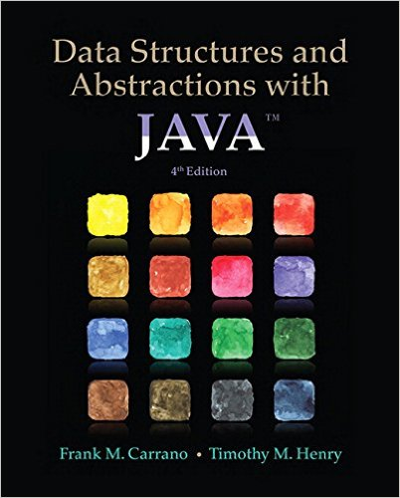
Lecture 7
Chapter 9: Faster Sorting Methods

Slide 2
Contents
Merge Sort
  Merging Arrays
  Recursive Merge Sort
  The Efficiency of Merge Sort
  Iterative Merge Sort
  Merge Sort in the Java Class Library

Slide 3
Contents
Quick Sort
  The Efficiency of Quick Sort
  Creating the Partition
  Java Code for Quick Sort
  Quick Sort in the Java Class Library
Radix Sort
  Pseudocode for Radix Sort
  The Efficiency of Radix Sort
Comparing the Algorithms

Slide 4
Objectives
Sort array into ascending order using
  merge sort
  quick sort
  radix sort
Assess efficiency of a sort and discuss relative efficiencies of various methods

Slide 5
Book Sorting Assignment

Slide 6
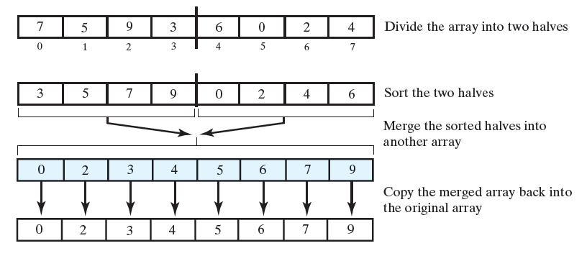
Merge Sort
Divide array into two halves
  Sort the two halves
  Merge them into one sorted array
Uses strategy of “divide and conquer”
  Divide problem up into two or more distinct, smaller tasks
Good application for recursion

Slide 7
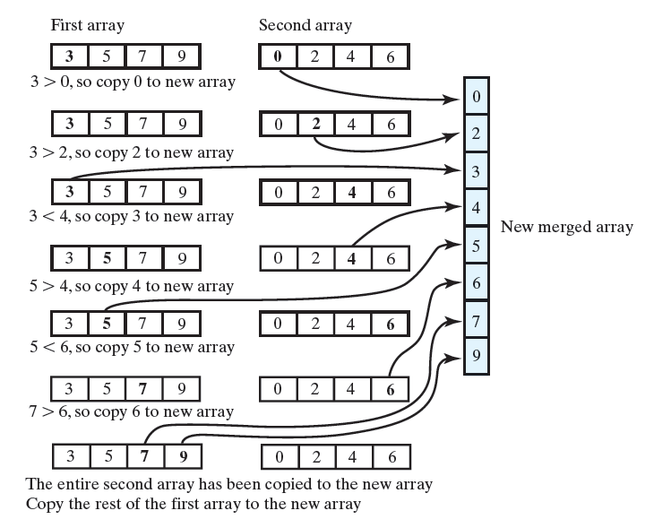
Figure 9-1 Merging two sorted arrays into one sorted array

Slide 8
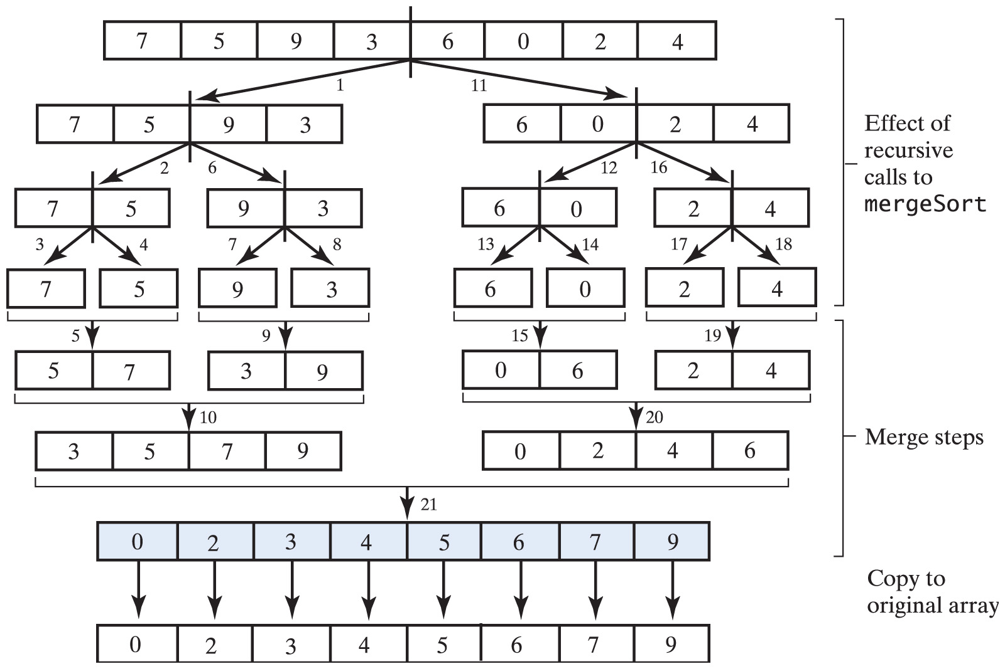
Recursive Merge Sort
Algorithm mergeSort(a, first, last)
// Sorts the array elements a[first] through a[last] recursively.
if (first < last)
{
mid = first + (last - first)/2
mergeSort(a, first, mid)
mergeSort(a, mid+1, last)
Merge the sorted halves a[first..mid] and a[mid+1..last]
}
View mergeSort algorithm

Slide 9
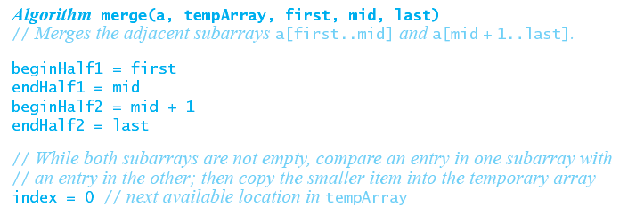
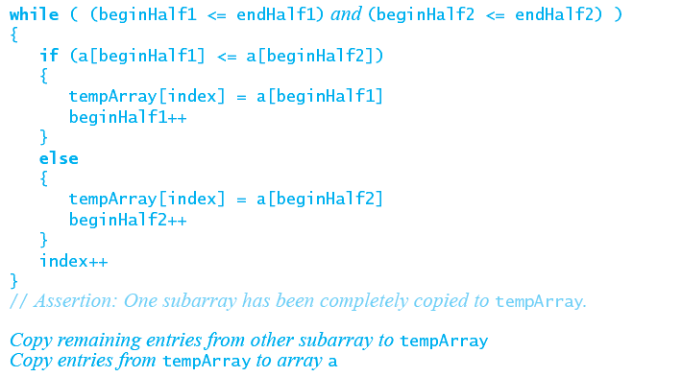
Algorithm to Merge the Sorted Halves

Slide 10
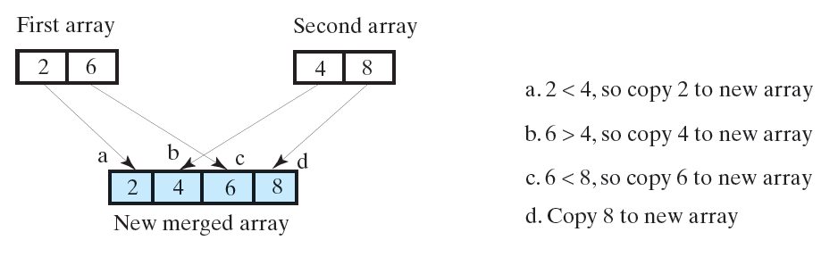
Efficiency of Merge Sort
For n = 2^{k} entries
  In general k levels of recursive calls are made
Each merge requires at most 3n – 1 comparisons
Calls to merge do at most 3n – 2² operations
Can be shown that efficiency is O(n log n)

Slide 11
Iterative Merge Sort
More difficult than recursive version
  Recursion controls merging process
  Iteration would require separate control
Iterative more efficient in time, space required
  More difficult to code correctly

Slide 12
Merge Sort in the Java Class Library
Class Arrays in java.util has sort methods
  public static void sort(Object[] a)
  public static void sort
  (Object[] a, int first, int after)
These methods use merge sort
  Merge step skipped if none of entries in left half, greater than entries in right half
The merge sorts in JDK are stable:
  a sorting algorithm is stable if it does not change the relative order of objects that are equal
  stability is important to certain applications. For example, suppose that you sort a group of people, first by name and then by age. A stable sorting algorithm will ensure that people of the same age will remain in alphabetical order

Slide 13
Recursive Merge Sort
See the visualization
See the Merge Sort as dance

Slide 14
Recursive Merge Sort
Algorithm mergeSort(a, first, last)
// Sorts the array elements a[first] through a[last] recursively.
if (first < last)
{
mid = first + (last - fist)/2
mergeSort(a, first, mid)
mergeSort(a, mid+1, last)
Merge the sorted halves a[first..mid] and a[mid+1..last]
}
Trace the steps that a merge sort takes when sorting the following array into ascending order:
9 6 2 4 8 7 5 3
19 6 2 4
29 6 62 4
39 46 72 84
56 9 92 4
102 4 6 9
118 7 5 3
128 7 165 3
138 147 175 183
157 8 193 5
203 5 7 8
2 3 4 5 6 7 8 9

Slide 15
Parallel In-Place Merge Sort
in news: http://goo.gl/k7Gof4

Slide 16
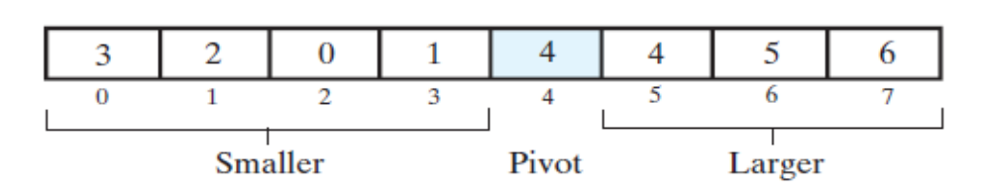
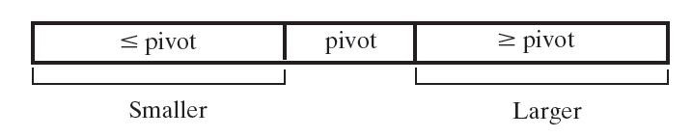
Quick Sort
Algorithm quickSort (a, first, last)
// Sorts the array elements a[first] through a[last] recursively.
if (first < last)
{
Choose a pivot
Partition the array about the pivot
pivotIndex = index of pivot
quickSort (a, first, pivotIndex - 1) // sort Smaller
quickSort (a, pivotIndex + 1, last) // sort Larger
}
Divides arrays into three portions:
One – single entry called the “pivot”
  Pivot is in position that it will occupy in final sorted array, so once inserted its index will never change
“Smaller “sub-array
  Entries in positions before pivot are less than or equal to the pivot
“Larger” sub-array
  Entries in positions after pivot are greater than or equal to the pivot

Slide 17
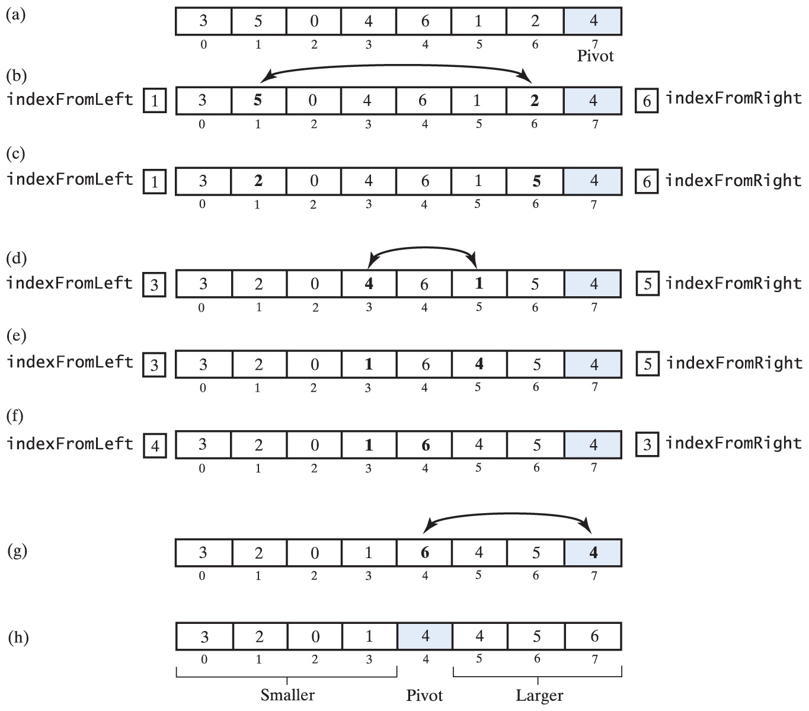
Quick Sort Partitioning Strategy
look for
element >= pivot
look for
element <= pivot
any choice will do, so why not select the last element as pivot
2 <= pivot
5 >= pivot
after swap
1 <= pivot
4 >= pivot
after swap
indexFromLeft >= indexFromRight
swap pivot with the larger
first pass finished

Slide 18
Quick Sort
See the visualization
See the Quick Sort as dance

Slide 19
Efficiency of Quick Sort
For n items
  n comparisons to find pivot
If every choice of pivot cause equal sized arrays, recursive calls halve the array
Results in O(n log n)

Slide 20
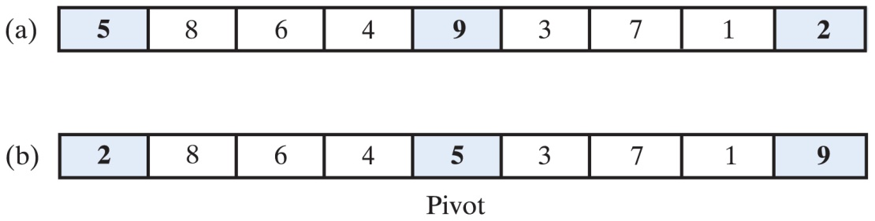
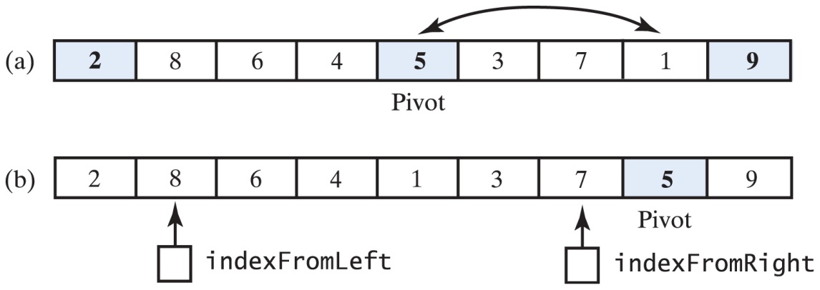
Median-of-Three Pivot Selection
the original array
(b) the array with its first, middle, and last elements sorted
need to move the pivot out of the way – swap with the second last
(d) the array after positioning the pivot and just before partitioning
Note the positions of indexFromLeft and indexFromRight

Slide 21
Java Code for Quick Sort
Java Class Library – Class Arrays uses quick sort for primitive types
  public static void sort(type[] a)
  public static void sort
  (type[] a, int first, int after)
Is quick sort a stable sorting algorithm?
  NO – quick sort rearranges the entries in an array during the partitioning process.
  HOWEVER each partition places one entry – the pivot – in its correct sorted position. The entries in each of the two sub-arrays that are before and after the pivot will remain in their respective sub-arrays

Slide 22
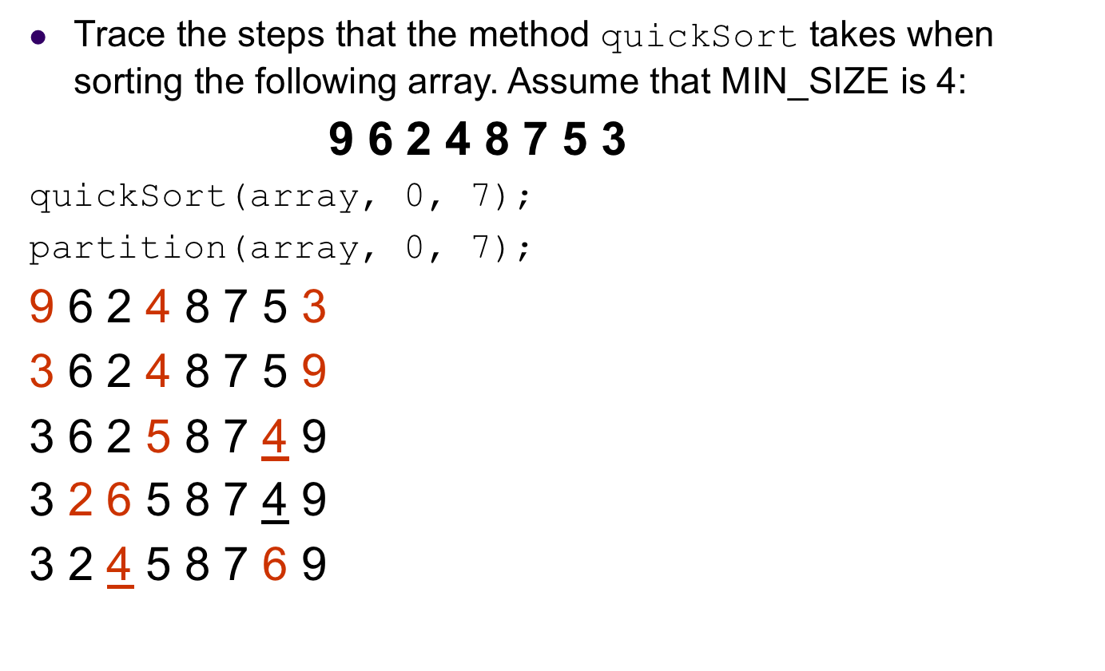
Quick Sort
public static < T extends Comparable < ? super T >>
void quickSort (T [] a, int first, int last)
{
if (last - first + 1 < MIN_SIZE)
{
insertionSort (a, first, last);
}
else
{
// create the partition: Smaller | Pivot | Larger
int pivotIndex = partition (a, first, last);
// sort subarrays Smaller and Larger
quickSort (a, first, pivotIndex - 1);
quickSort (a, pivotIndex + 1, last);
} // end if
} // end quickSort

Slide 23
Quick Sort
3 2 4 5 8 7 6 9
quickSort(array, 0, 1);
insertionSort(array, 0, 1);
2 3 4 5 8 7 6 9
quickSort(array, 3, 7);
partition(array, 3, 7);
2 3 4 5 8 7 6 9
2 3 4 5 8 6 7 9
2 3 4 5 6 8 7 9
2 3 4 5 6 7 8 9
public static < T extends Comparable < ? super T >>
void quickSort (T [] a, int first, int last)
{
if (last - first + 1 < MIN_SIZE)
{
insertionSort (a, first, last);
}
else
{
// create the partition: Smaller | Pivot | Larger
int pivotIndex = partition (a, first, last);
// sort subarrays Smaller and Larger
quickSort (a, first, pivotIndex - 1);
quickSort (a, pivotIndex + 1, last);
} // end if
} // end quickSort

Slide 24
Quick Sort
2 3 4 5 6 7 8 9
quickSort(array, 3, 4);
insertionSort(array, 3, 4);
2 3 4 5 6 7 8 9
quickSort(array, 6, 7);
insertionSort(array, 6, 7);
2 3 4 5 6 7 8 9
public static < T extends Comparable < ? super T >>
void quickSort (T [] a, int first, int last)
{
if (last - first + 1 < MIN_SIZE)
{
insertionSort (a, first, last);
}
else
{
// create the partition: Smaller | Pivot | Larger
int pivotIndex = partition (a, first, last);
// sort subarrays Smaller and Larger
quickSort (a, first, pivotIndex - 1);
quickSort (a, pivotIndex + 1, last);
} // end if
} // end quickSort

Slide 25
Merge Sort vs Quick Sort Match

Slide 26
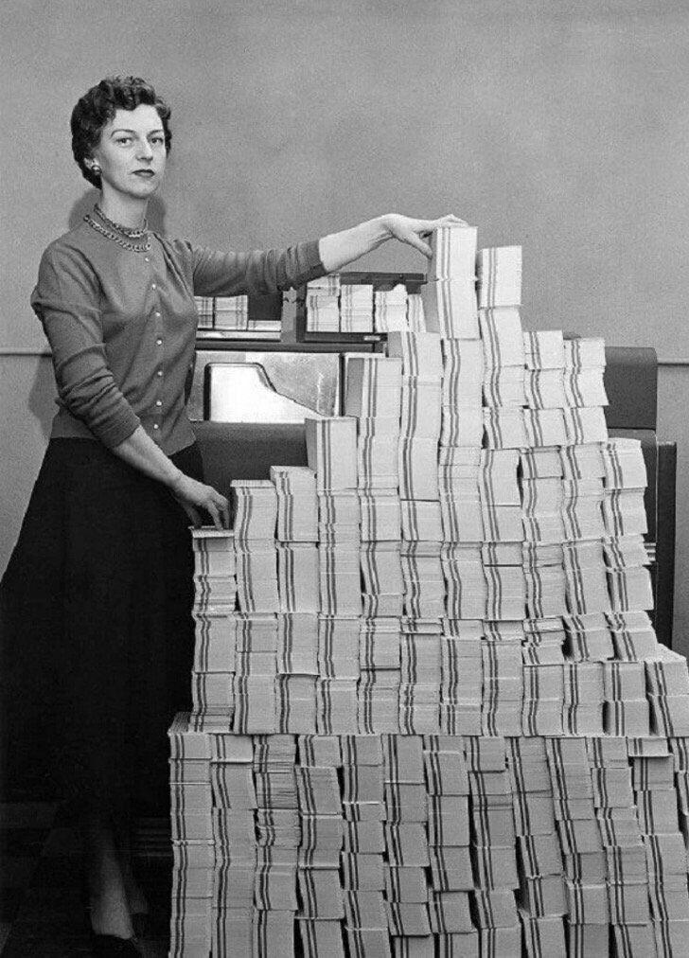
Radix Sort
Originated with card sorters when computers used 80 column punched cards (see also wikipedia)
4.5 megabytes of data in 62,500 punched cards, USA, 1955

Slide 27
Radix Sort
Does not compare objects
Treats array elements as if they were strings of the same length
Groups elements by a specified digit or character of the string
  Elements placed into "buckets" which match the digit (character)

Slide 28
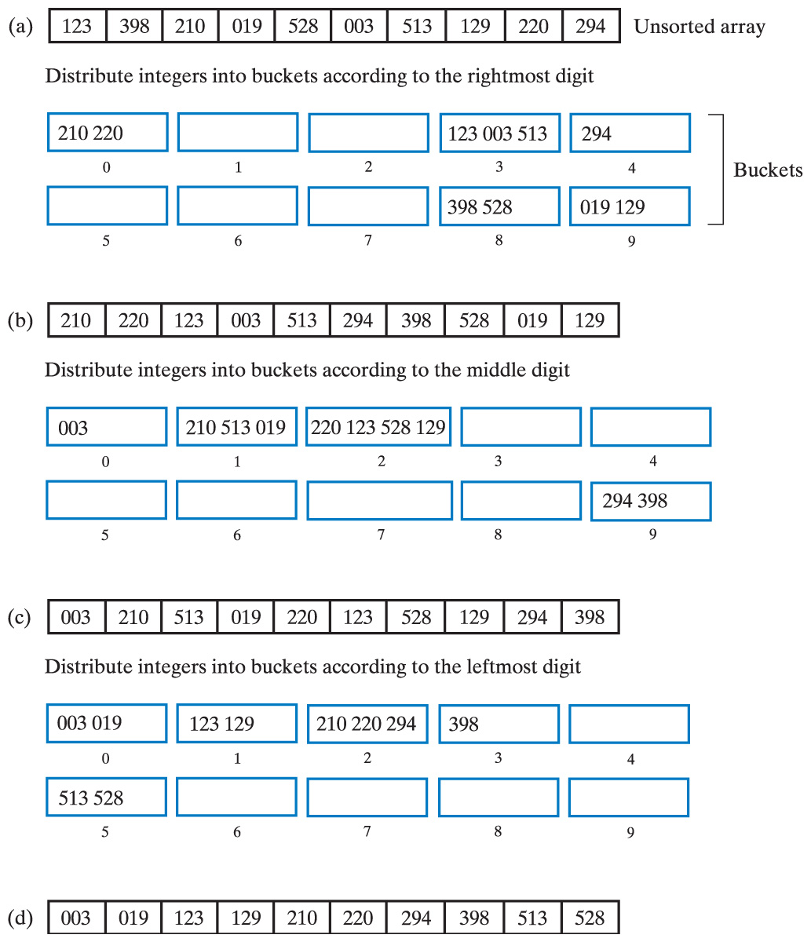
Radix Sort
Original array and buckets after first distribution;
reordered array and buckets after second distribution
reordered array and buckets after third distribution;
sorted array
http://www.youtube.com/watch?v=2RCgIrZiC6c

Slide 29
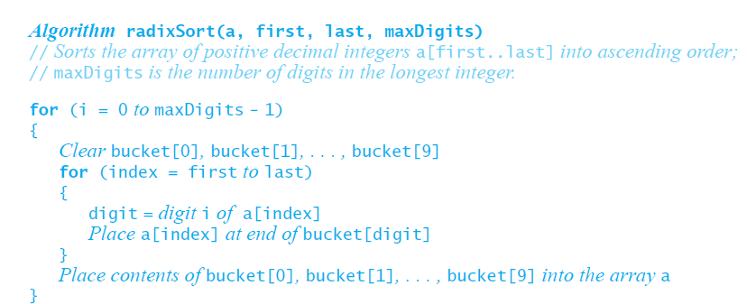
Radix Pseudocode

Slide 30
Algorithm radixSort (a, first, last, maxDigits)
// Sorts the array of positive decimal integers a[first..last]
// into ascending order
// maxDigits is the number of digits in the longest integer.
for (i = 0 to maxDigits - 1)
{
Clear bucket [0], bucket [1], . . . , bucket [9]
for (index = first to last)
{
digit = digit i of a [index]
Place a [index] at end of bucket [digit]
}
Place contents of bucket [0], bucket [1], . . . , bucket [9] into the array a
}
Radix Sort
Trace the steps that the algorithm radixSort takes when sorting the following array:
6340 1234 291 3 6325 68 5227 1638
6340 0291 0003 1234 6325 5227 0068 1638
0003 6325 5227 1234 1638 6340 0068 0291
0003 0068 5227 1234 0291 6325 6340 1638
0003 0068 0291 1234 1638 5227 6325 6340

Slide 31
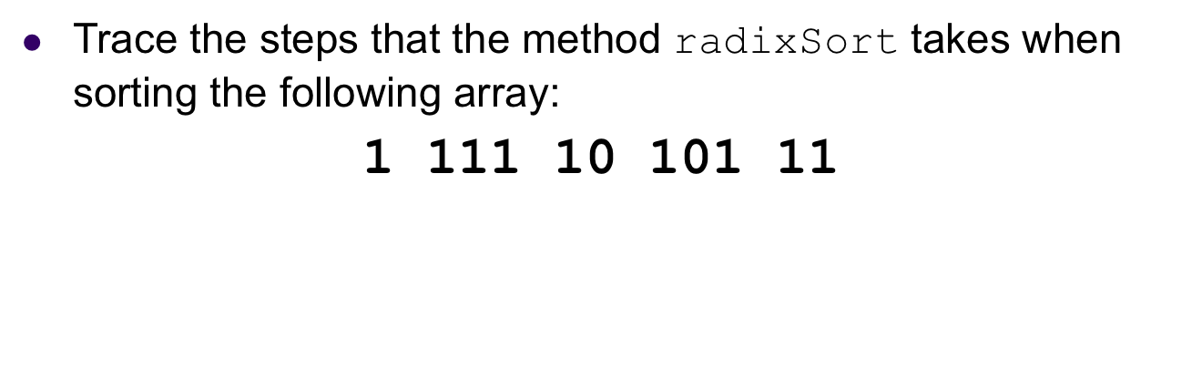
Radix Sort
Algorithm radixSort (a, first, last, maxDigits)
// Sorts the array of positive decimal integers a[first..last]
// into ascending order
// maxDigits is the number of digits in the longest integer.
for (i = 0 to maxDigits - 1)
{
Clear bucket [0], bucket [1], . . . , bucket [9]
for (index = first to last)
{
digit = digit i of a [index]
Place a [index] at end of bucket [digit]
}
Place contents of bucket [0], bucket [1], . . . , bucket [9] into the array a
}

Slide 32
Radix sort
Example of radix sort on numbers:
  this time we will look at their binary representation
  in practice, we can do this faster if we think of integers as binary numbers and we consider radix to be 2.
  For example: 7 2 5 3 are saved in memory in binary as:
  111 010 101 011
  bucket 0: 010
  bucket 1: 111 101 011
  010 111 101 011
  bucket 0: 101
  bucket 1: 010 111 011
  101 010 111 011
  bucket 0: 010 011
  bucket 1: 101 111
  010 011 101 111
  2 3 5 7

Slide 33
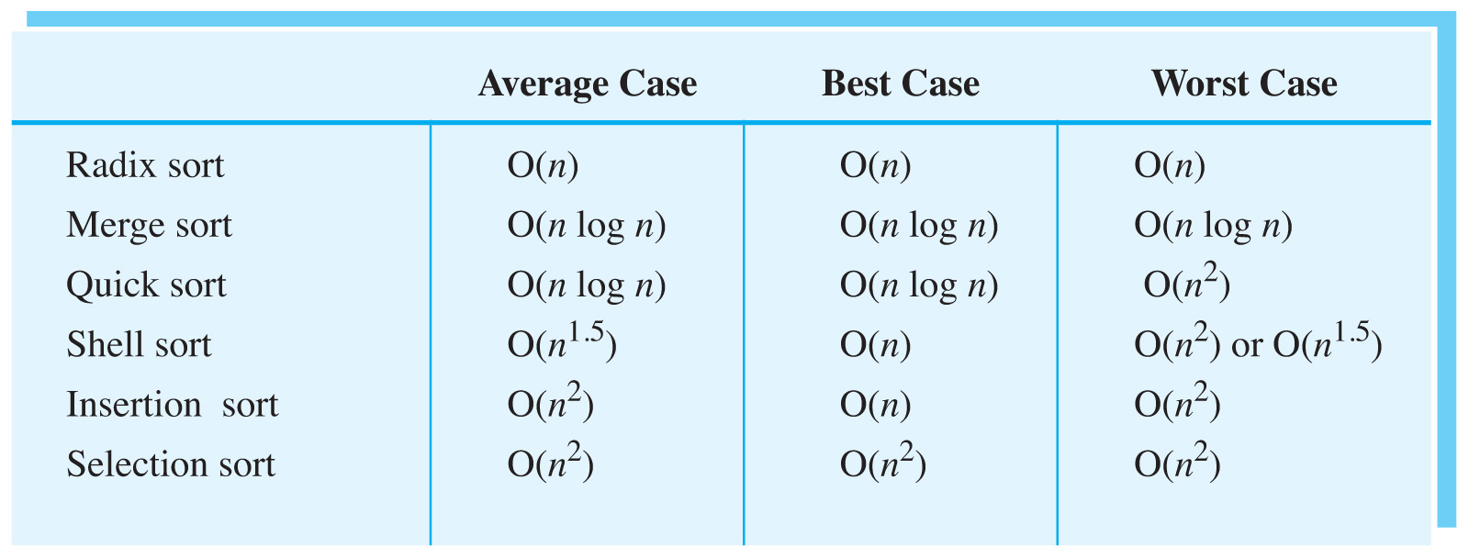
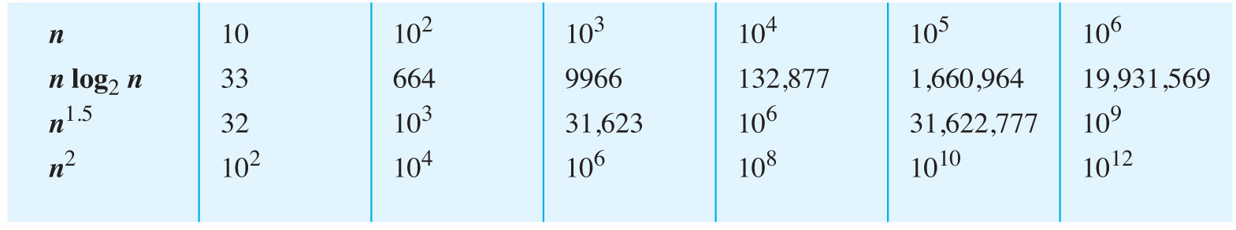
Comparing the Algorithms
A comparison of growth-rate functions as n increases:

Slide 34
Comparing the Algorithms
What different sorting algorithms sound like
16 Sorts – color circle
Sorting Contest
Google job interview question ☺
Algorithms BBC

